Slide 1
C++ Programming Today 2nd Edition By Barbara Johnston Chapter 3
Instructor: <Instructor Name>
Lecture Slides by Kelly Montoya and Rob Garner

Slide 2
Chapter 3
Relational and Logical Operators
If statements
Ternary Operator
Switch Statements
Loop control structures
For Loops
While Loops
Do While Loops
Program flow control statements
Common Errors
Reading numbers and strings
Vector Class
Review
Random Number Generation

Slide 3
Loop control structures
Explain how to use loop control structures

Slide 4
Loops in General
A loop enables the program to loop over or repeat statements.
This iterative process may be set up so that the loop is executed a predetermined number of times or until a certain condition is met.
C++ language provides three methods for performing loops:
the for loop
the while loop
do while loop

Slide 5
All loops in C++ have either a loop index, counter variable, or stopping variable, and the following steps must be taken:
1. An initial assignment for the loop counter or stopping variable.
2. A condition such that, when it is true, it will cause the loop to be executed, and when it is false, it will cause the program to stop the loop.
3. Loop altering statement that will adjust the counter or stopping variable.

Slide 6
For Loops
Explain how to use a for loop.

Slide 7
for Loop
The for loop is a convenient C++ statement for use when the programmer knows exactly how many times the statements must be repeated.
This loop structure has the following format:
for(initialization; test condition; loop update)
{
//statements are executed if condition
//is true
}

Slide 8
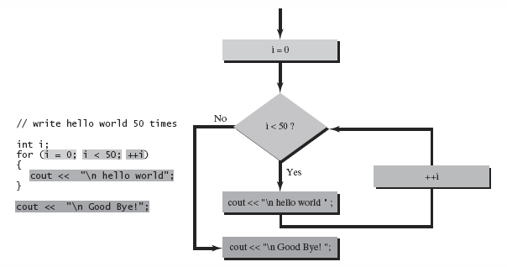
for Loop
The for loop is illustrated as a flow diagram.

Slide 9
for Loop
Here is an example of writing hello world to the screen fifty times:
int i;
for(i = 0; i < 50; ++i)
{
cout << "\n hello world";
}
i: 0
i: 1
i: 3
hello world
i: 2
hello world
hello world
hello world

Slide 10
Write a for loop that count from 0 to 9.

Slide 11
While Loops
Explain how to use while loop.

Slide 12
while Loop
The while loop is needed when the programmer does not know how many times a loop is to be executed.
Since the condition is checked first, it is possible that the loop will not execute.
The while loop can also be used to perform a loop an exact number of times.

Slide 13
while Loop
The while loop format is shown below:
The while loop checks the condition and if it is true, the loop statements are performed.
If the condition is false, the statements are skipped.
while(condition)
{
//these done if condition is true
}
Notes:
Programs 3-8 and 3-9 illustrate while loops.

Slide 14
while Loop
Show Prog 3-8, 3-9
While count is less than 50, “hello world” is written to the screen.
The count is incremented and checked again. When it becomes 51,
the condition is false and “Good Bye!” is written.

Slide 15
Write a while statement that will display the numbers from 10 to -10.

Slide 16
Do While Loops
Explain how to use a do while loop.

Slide 17
do while Loop
The do while loop is very similar to the while loop, but the condition check is performed at the end of the loop.
Loop statements are always performed at least once—unlike the for and while loops.
do while format:
do
{
//loop statements
} while(condition);

Slide 18
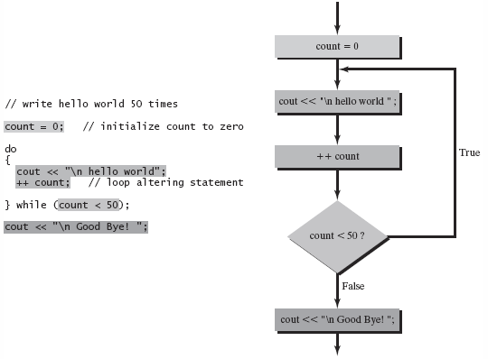
do while Loop
Show Prog 3-10
In this do while loop, count is checked at the end of the loop.
Notes:
See Program 3-10 for a do while example.

Slide 19
Write a do while statement that will display the numbers from 7 to 1.

Slide 20
Loops Demo
Demonstrate how to use loops.

Slide 21
Chapter 3
Relational and Logical Operators
If statements
Ternary Operator
Switch Statements
Loop control structures
For Loops
While Loops
Do While Loops
Program flow control statements
Common Errors
Reading numbers and strings
Vector Class
Review
Random Number Generation

